Slide 1

Traditional GeoGuessr AI
Ratoi Razvan
Group 30442

Slide 2
The Objective
The project’s objective is to implement a classifier that would receive as input an image and give as output the country that image was taken from, using the K-Nearest Neighbour Classifier.
*Note: Only a selection of countries was used for training the model.

Slide 3
Definitions
Classifier = a program whose purpose is to assign a class to an unknown sample.
Sample = an image, characterized by features.
Features = histograms of the segments, concatenated.

Slide 4



K-Nearest Neighbour Classifier – Step 1
Pre-process training data set.
Compute Histograms
X, Y
Data Set

Slide 5

K-Nearest Neighbour Classifier – Step 2
Process the sample the same way as the data set.
Compute Histogram
Sample Histogram
Sample Image

Slide 6
Pre-processing Methods
Convert the images from RGB to HSV
Quadrant segmentation:
Split the image into 4 quadrants, compute the histogram for each quadrant and then concatenate them.
Vertical segmentation:
Split the image into 4 strips vertically and compute the “sum histogram” the same way as before.
Horizontal segmentation:
Same method as above, but the segmentation is done horizontally

Slide 7
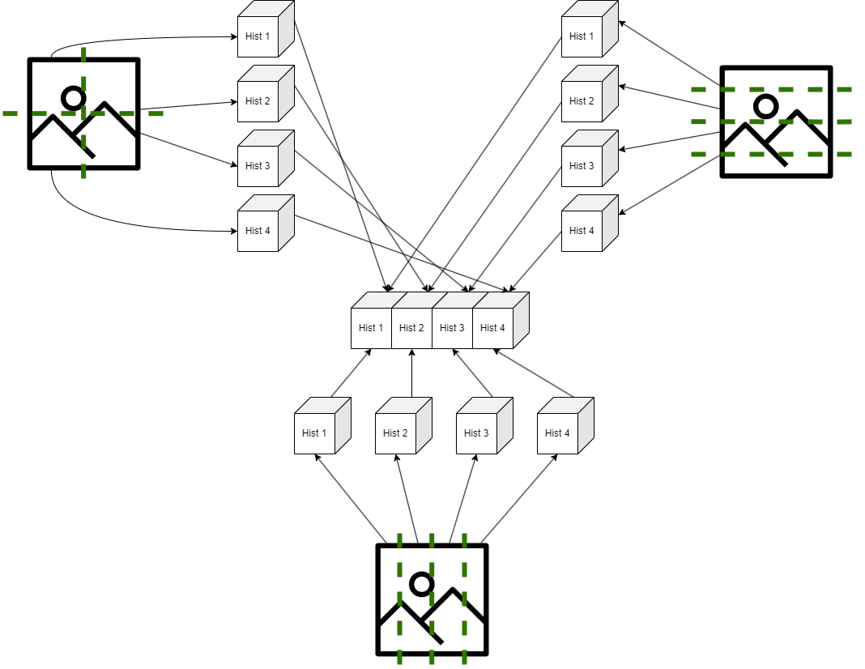

Slide 8
K-Nearest Neighbour Classifier – Step 3
Compute the distances between each entry of the training set (X) and the sample processed data (Sample Histogram)
using Manhattan/Euclidean distance (Manhattan proved better)
Store the distances and the corresponding classes in an array
Sort the distances increasingly based on the distances

Slide 9
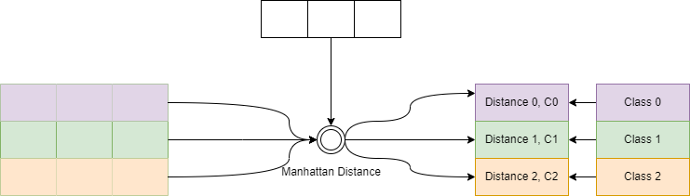
K-Nearest Neighbour Classifier – Step 3
Example:
Sample Histogram
X
Distance Array
Y

Slide 10
“Sorting” the distance array
The sorting action on this array is used to have the K smallest distances in the same place (the first K places in the array)
I managed to do this by the following pseudocode:
if array.size < K || newDistance < min(array)
array.push(newDistance)
if array.size > K
remove max(array)
This way, only the K smallest distances (and classes) are stored into the array

Slide 11
K-Nearest Neighbour Classifier – Step 4
Select the first K entries from the distance array
Keep track of their classes (count the frequency of each class)
The class that appears most frequently will be the prediction of the classifier

Slide 12
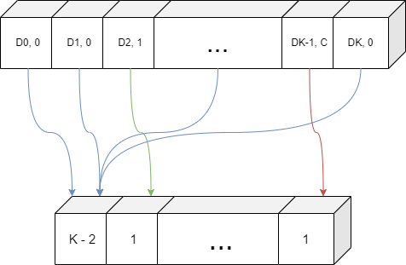

K-Nearest Neighbour Classifier – Step 4
Example:
Distance Array
Class 0
Voting Array
Class 0
Class 1
Class C

Slide 13
Implementation Details #1
calcHist: given the image, returns a histogram organized in bins
cvtColor: converts the images from 1 color space to another (OpenCV function)
getQuadrantHistograms: converts the image to HSV space, divides it into quadrants, computes the histogram (using calcHist) for each quadrant and then concatenates them.
getVerticalHistograms: the same as getQuadrantHistograms, but divides the image into 4 vertical strips.
getHorizontalHistograms: the same as getQuadrantHistograms, but divides the image into 4 horizontal strips.

Slide 14
Implementation Details #2
readDataset: for each image in the training data set, computes the histogram (based on the division methods) and stores it in the feature matrix X; also adds the class at the same index in the matrix Y. (also write the matrices to CSV files)
knnClassifier: given X, Y and the sample histogram, follows the K-Nearest Neighbour Classifier algorithm and returns the predicted class.
loadCSVtoMat: given the file’s name, it reads it and return a matrix with its contents.

Slide 15
Optimal K (Based on accuracy)
K / Division Method | Quadrant | Horizontal | Vertical
10 | 41.55% | 21.77% | 22.88%
29 | 45.77% | 24.44% | 23.77%
92 | 42.55% | 24.44% | 23.11%
140 | 40.44% | 26.33% | 21.88%

Slide 16
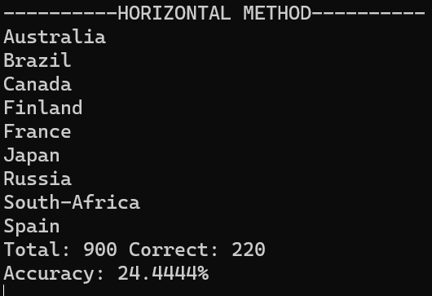
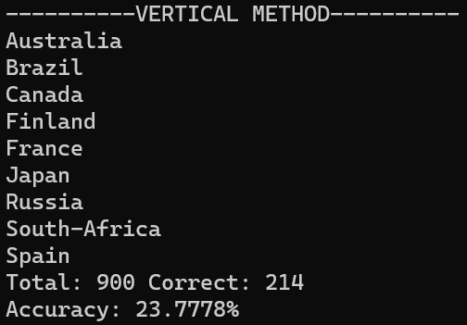
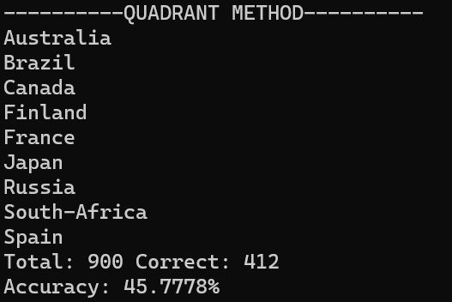
Results – Test Data Set

Slide 17
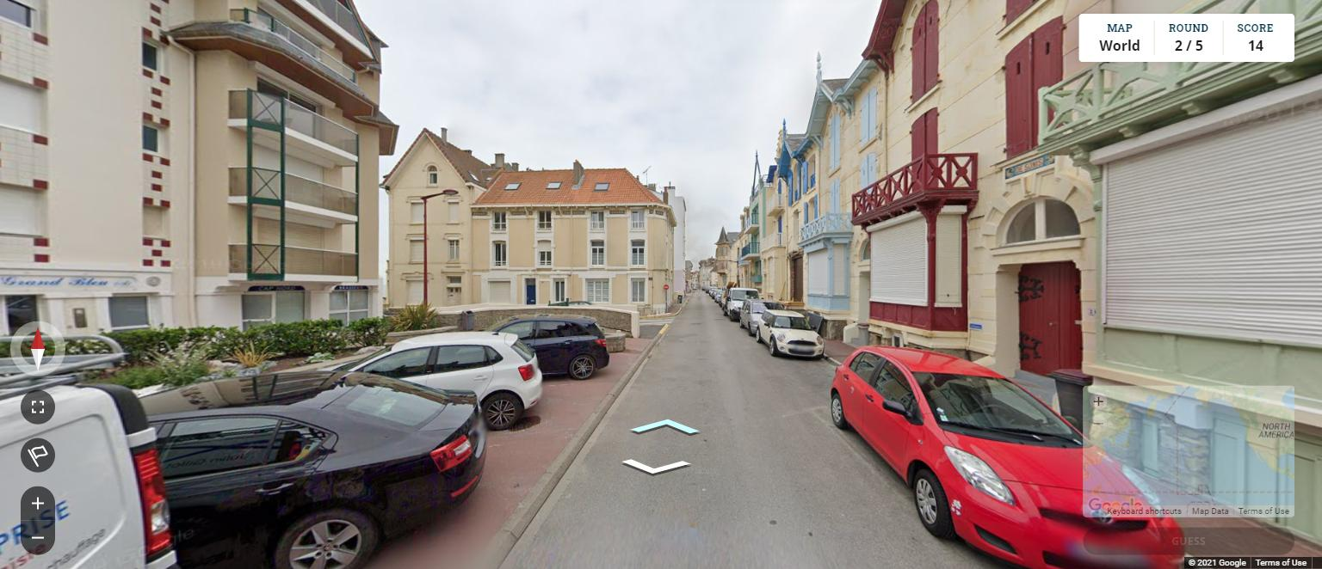
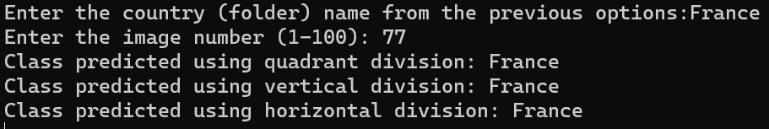
Results – Concrete Image Sample #1

Slide 18
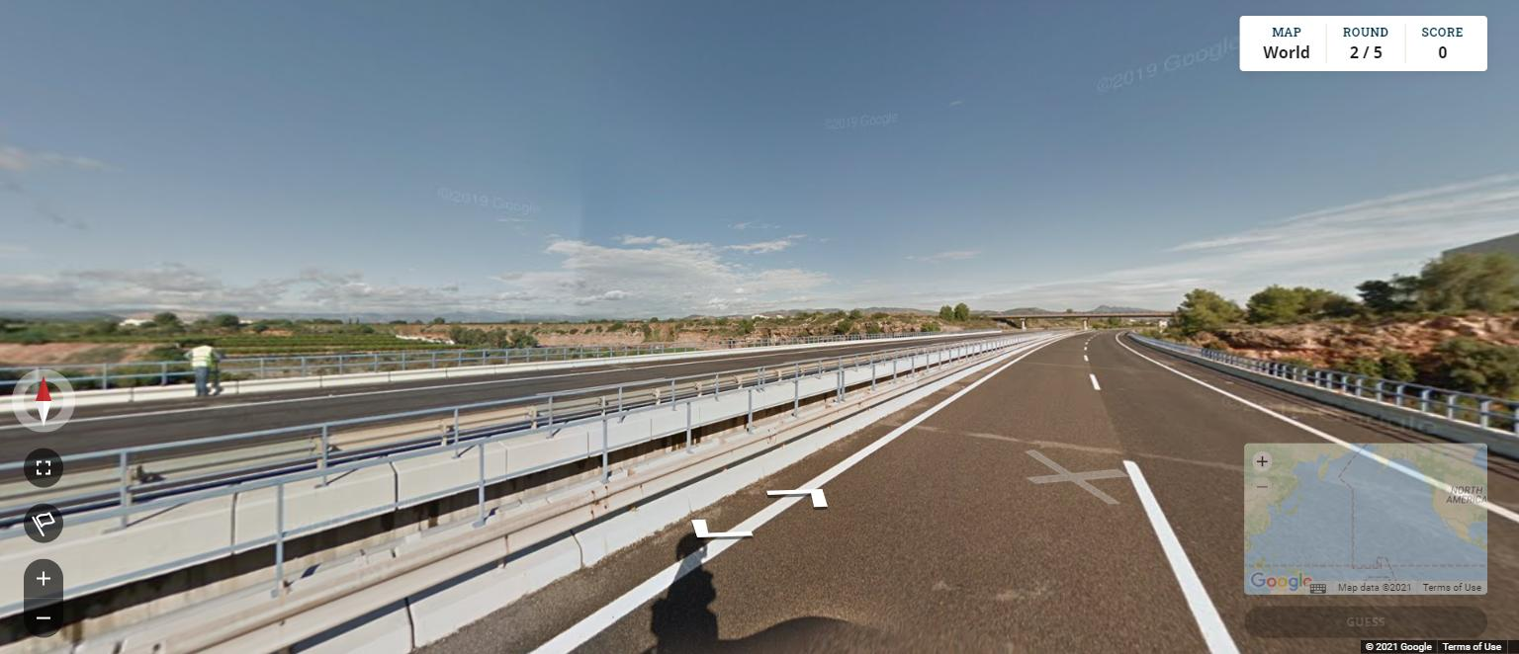
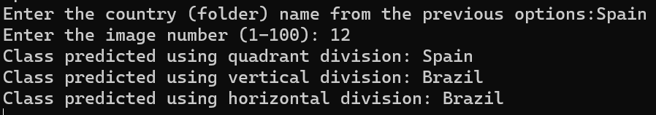
Results – Concrete Image Sample #2

Slide 19
Conclusions
Optimal K found: 29
Optimal method of division: Quadrant
Optimal color space: HSV
Optimal distance formula: Manhattan
Greatest obstacle: reading from CSV

